Slide 1
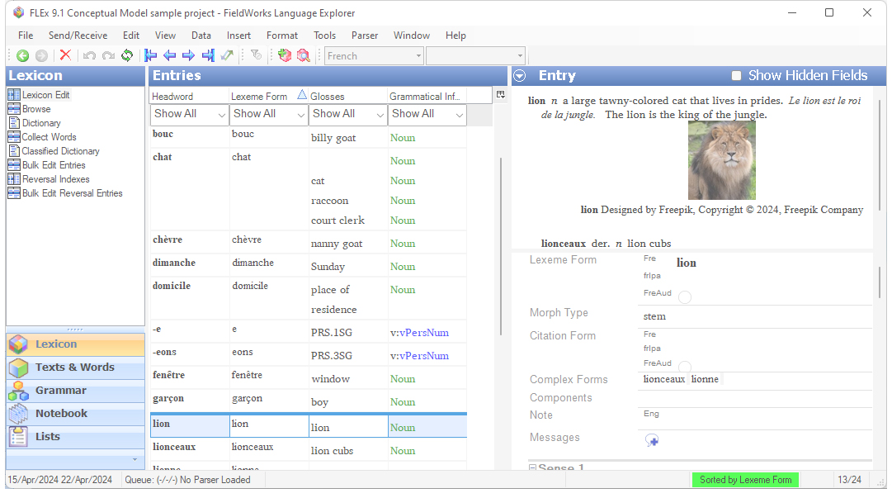
FLEx 9.1 Conceptual Model
Grammar and Interlinear model Ken Zook
June 25, 2024

Slide 2
Grammar: Introduction
Most objects in the grammar area come from factory lists that are provided with FLEx. The user normally chooses from these lists to provide the features they want.
The core part of the grammar is the Parts Of Speech list seen in the Category Edit tool in the Grammar area. In addition to providing names and abbreviations for categories, there are other details that can be added to a category including Affix Templates, Affix Slots, Inflection Class Info, Features, and Stem Names.
Using these features along with lexical entries, a user can use morphological parsers to validate morphology as specified by the grammar. These specifications affect the XAmple, HermitCrab, and interlinear parsers.
The Grammar area, provides various tools to list phonemes, phonological features and rules, natural classes, environments, inflection features, etc.
There is also a Grammar Sketch tool that will provide a sketch of your grammar at any point in time.
The Feature Types list in the Lists area is also related to Grammar and is not a true CmPossibility list.

Slide 3
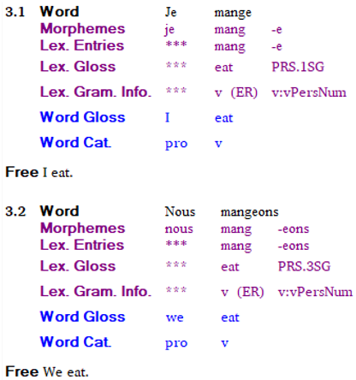
Grammar: Introduction continued
To illustrate some of the grammar capabilities, the sample project illustrates some basics for parsing French verbs that follow the ER paradigm. This can parse the verb ‘manger’ into ‘mange’ for first person singular (I eat), and ‘mangeons’ for third person singular (we eat). Once this is set up, it could parse other verbs that use the same affixes to determine person and number, as long as the other main entries are linked to the ‘ER Verbs’ Inflection Class in their Grammatical Info Details section.

Slide 4
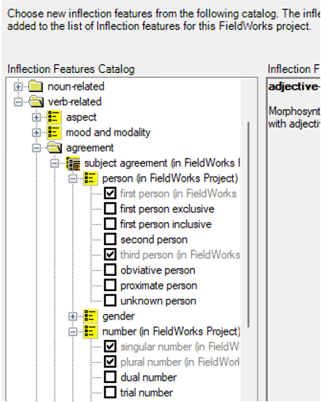
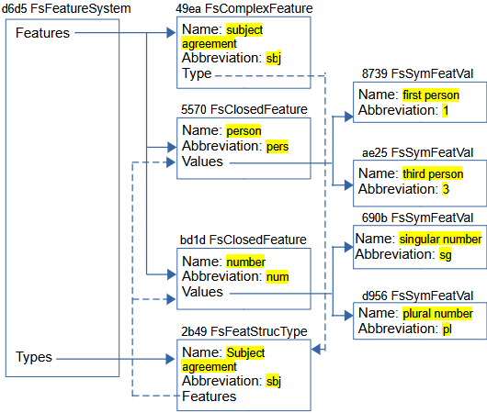
Grammar: Inflection features
The first step to do this is adding features. In the Inflection Features tool, add a new Complex Feature with check marks in person and number sections under subject agreement.

Slide 5
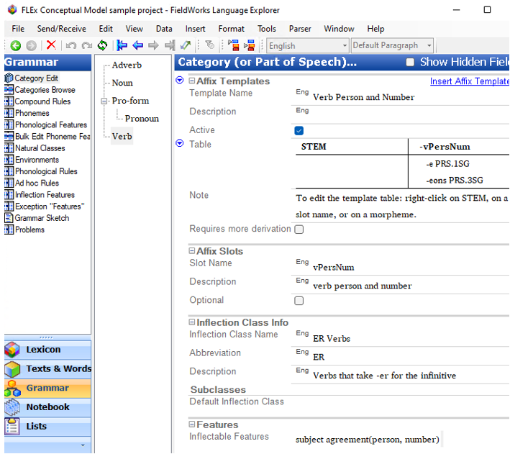
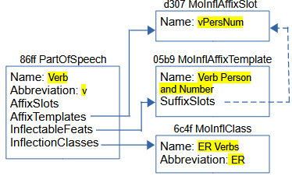
Grammar: Verb category
In Category Edit, add an Affix Template, an Affix Slot, and an Inflection Class Info to the Verb category. At this point, the affix template will not have any entries in the vPersNum column.

Slide 6

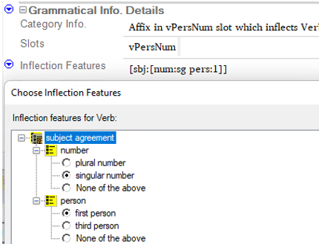
Grammar: User setup continued
In the entry for ‘manger’, specify the lexeme form as ‘mang’ and the citation form as ‘manger’. In the Grammatical Info Details section, the entry is classified as a verb, and the Inflection Class is set to ER Verbs.
In the ‘-e’ suffix entry, add the entry to the ‘vPersNum’ slot, and set the Inflection features to ‘singular number’ and ‘first person’.
Make similar changes to the ‘-eons’ entry, except person is set to ‘third person’, and number is set to ‘plural number’.
mang / manger
-e

Slide 7
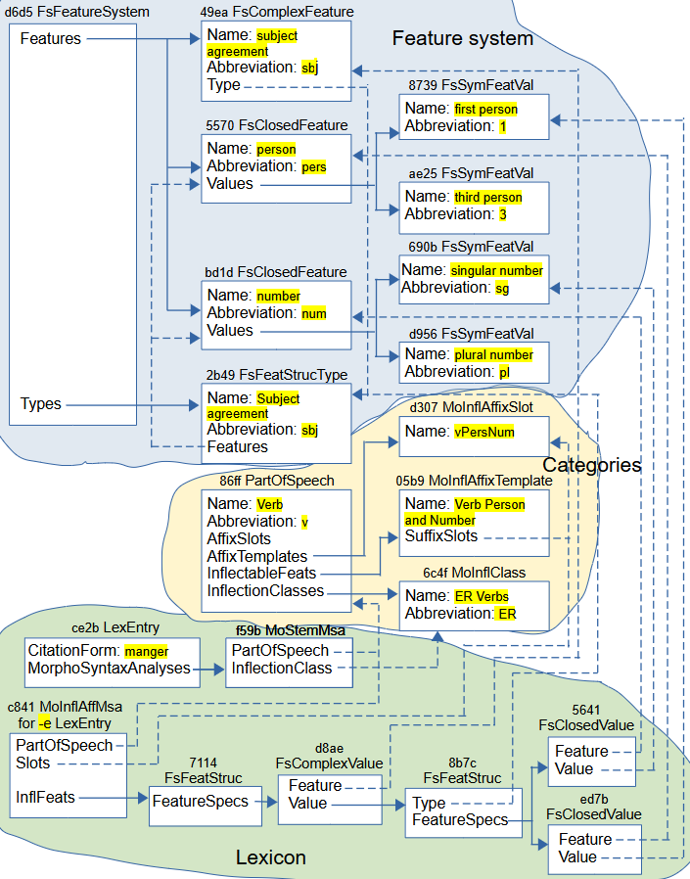
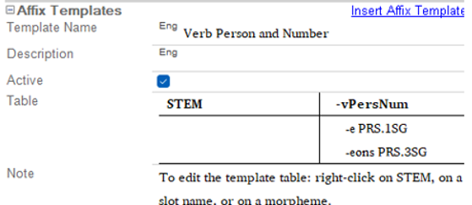
Grammar: with lexicon
MoStemMsa references category and MoInflClass.
MoInflAffMsa references category and MoInflAffixSlot
MoInflAffMsa owns a FsFeatStruc connection to various parts of the feature system

Slide 8
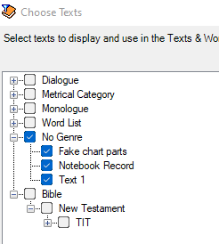
Interlinear Introduction
FLEx maintains a wordform inventory based on unique words in baselines of interlinear texts in the Texts & Words area.
The wordform inventory can be viewed in the Word Analyses tool in the Texts & Words area.
Initially capitalized and uncapitalized words are both included because it is unknown whether they should be different or not.
The wordforms shown in Word Analyses are limited to ones in the texts filter. To change the filter, go to View > Choose Texts, or use the Choose Texts icon in the toolbar. This will show all of the texts in the project. Ones with checkmarks are in the current filter that affects what you see in Word Analyses and Interlinear Texts.

Slide 9
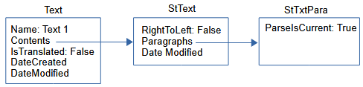
Interlinear: Structured text
Suppose we create a new Text 1 interlinear text without typing anything in the baseline. This is what we have in FLEx.
An interlinear text is implemented by a Text object that has
Name - MultiUnicode inherited from CmMajorObject shown as the Title in the UI.
Abbreviation – MultiUnicode inherited from CmMajorObject
Contents – atomic owning property holding a StText
IsTranslated - Boolean to indicate if it’s translated text, such as scripture, or original text.
DateCreated and DateModified inherited from CmMajorObject
Source – MultiString
Genres – reference collection to CmPossibility in the Genres list. This allows texts to be hierarchically arranged in the Choose Texts dialog making it easier to filter on certain types of text.
Text objects do not have owners. Most of these Text properties can only be seen or modified in the Info tab in the Interlinear Texts tool.

Slide 10
Interlinear: Structured text continued
StText (Structured Text) is a class in FLEx that can hold any number of paragraphs (StTxtPara) that can have styles associated with paragraphs and text in paragraphs. An StText can be used kind of like a Google document. Whenever you press the Enter key, it starts a new StTxtPara at that point. StText has
Paragraphs – an owning sequence of StPara which is abstract, and is implemented as StTxtPara or ScrTextPara (for Scripture).
DateModified – Time when modified
RightToLeft – Boolean. True if the text is right-to-left, or False if left-to-right.
Tags – owning collection of TextTag (used in text tagging).

Slide 11
Interlinear: Structured text continued
StTxtPara stores the text for the baseline of the paragraph, plus additional information for interlinearization. StTxtPara has
Contents – String holding the baseline text.
Segments – an owning sequence of Segment for interlinearization.
ParseIsCurrent – Boolean. True if the Segments have not changed since they were last parsed, or False if they need to be reparsed.
StyleRules – Used where paragraph and text styles are allowed.
In the empty Text diagrammed here, the only real information is the title of the text in the Name property of Text. The StTxtPara does not have any text in the baseline at this point.

Slide 12
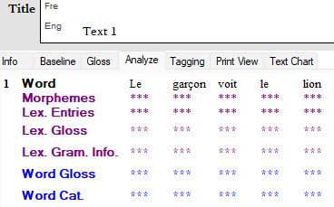
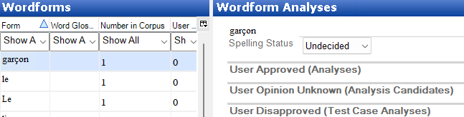
Interlinear: Segment
If we now type a text in the baseline and go to the Analyze tab, it will look like this, assuming none of the words are in the lexicon and you haven’t done any previous analyses. Word Analyses will show this.

Slide 13
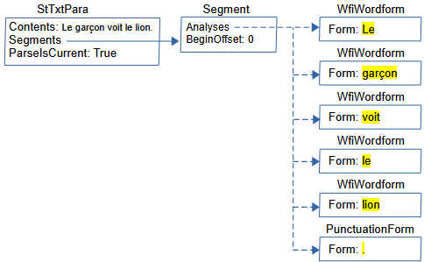
Interlinear: Segment continued
At this point, the implementation in FLEx starting at StTxtPara is this.

Slide 14
Interlinear: Segment continued
Segment is a class that holds all the information that is relevant to the analysis of a sequence of words ending in period, question mark, exclamation point, or section sign (U+00A7). Segment has
Analyses – reference sequence to IAnalysis, which is an interface that includes WfiWordform, WfiAnalysis, WfiGloss, and PunctuationForm.
BeginOffset – An integer giving the offset from the beginning of the Contents string in StTxtPara to the beginning of this segment. This allows FLEx to find the section of baseline text in the StTxtPara Contents string that is covered by this Segment.
FreeTranslation – MultiString giving the free translation of the text in this segment.
LiteralTranslation – MultiString giving the literal translation of the text in this segment.
Notes – owning sequence of Note, allowing notes to be added to this segment.
Other properties used to store information from ELAN, but not currently covered by FLEx UI include BeginTimeOffset, EndTimeOffset, MediaURI, Reference, and Speaker.
Custom fields are also possible on Segment.

Slide 15
Interlinear: Segment continued
The baseline is stored in the Contents String of StTxtPara.
FLEx breaks the baseline from the paragraph into segments ending in period, question mark, exclamation point, or section sign (U+00A7). Since there is only one period in this example, we only need one Segment in the Segments owning sequence property. In this case, the segment starts at the beginning of the string, so BeginOffset is set to 0.
As editing takes place, FLEx attempts to keep the Analyses accurately matching the baseline.
During Send/Receive, it’s not always possible to keep everything current. When this happens, FLEx sets ParseIsCurrent on StTxtPara to False. The next time that Text is opened, FLEx will reparse the baseline text and resets the Analyses to reflect the current state of the data.
A user can also force this operation at any time by using Tools > Utilities > Force Rechecking Word Breaks. This sets all of the StTextPara ParseIsCurrent flags to false. When you go to the Word Analyses tool, or the Concordance tool, FLEx will automatically reparse all Texts and reset the flags to True.

Slide 16


Interlinear: Segment continued
This is a free translation and a Note at the bottom of a Segment.
This is how it is implemented in FLEx (omitting other Segment fields)

Slide 17
Interlinear: Wordforms
FLEx breaks the baseline text for this segment into wordforms based on space and punctuation, then finds an existing WfiWordform that matches the wordform, or creates a new WfiWordform with the text from the wordform which is stored in the MultiUnicode Form field of WfiWordform.
WfiWordform objects do not have owners.
The Analyses reference sequence property on Segment stores a reference to each WfiWordform or PunctuationForm.
When Analyses reference WfiWordform, it means there is no analysis for this word at this point. In the display, this is shown by 3 asterisks in each field.
Punctuation is stored in PunctuationForm objects and referenced from Analyses. The Form field for PuncutationForm is a String property.
When creating a new interlinear text, if you have more than one vernacular writing system, FLEx will ask which writing system you will be using for this text. This is not stored in any property. The writing system of the first character of the baseline is the only way to determine this. Any runs that are not in this writing system in the baseline are stored in PunctuationForm objects rather than WfiWordform objects.
Any text in PunctuationForm objects cannot be analyzed.

Slide 18
Interlinear: Wordforms continued
PunctuationForm objects are never deleted. Because they will be created if a person uses any writing system other than the vernacular writing system for the baseline, they should avoid this as much as possible. If the project gets cluttered with many unneeded PuncuationForm objects, they can all be deleted. In Notepad++, you can delete all PunctuationForm objects from fwdata by using this regular expression search and replace.
Search <rt class="PunctuationForm".*\r\n<Form>\r\n<Str>\r\n<Run.*\r\n</Str>\r\n</Form>\r\n</rt>\r\n Replace (leave empty)
After doing this, you need to run Tools > Utilities > Find and fix… from another project to process your repaired project to remove any references to the deleted punctuation forms.
Then open the project and use Tools > Utilities > Force Rechecking Word Breaks.
Then go to Concordance or Word Analyses which will reparse everything and add new PunctuationForm objects where needed.

Slide 19
Interlinear: Wordforms continued
Wordforms should be unique. If duplicates somehow occur, you can run Tools > Utilities > Merge Duplicate Wordforms to merge them together. This will copy the analyses from the duplicate ones into a single wordform. After running this, you should run Tools > Utilities > Merge Duplicate Analyses. This will merge any duplicate analyses in the wordforms.
FLEx can interlinearize texts in different vernacular writing systems. There are various issues involved in doing this. See section 13, Interlinearizing with multiple scripts in https://downloads.languagetechnology.org/fieldworks/Documentation/Flex_tips.pdf before attempting to do this.

Slide 20
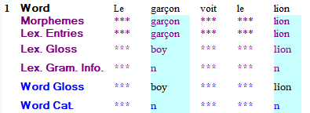
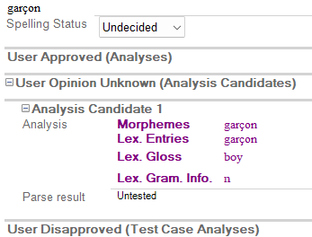
Interlinear: Analyses
Suppose the lexicon already has a definition for ‘lion’ and ‘garçon’? The interlinear display will now show this in the Analyze tab
Word Analyses will now show this for ‘garçon’
The user hasn’t done anything to the text, but FLEx found two words in the lexicon that matched a wordform, so it automatically created an analysis candidate that is shown in blue in the interlinear Analyze tab.

Slide 21
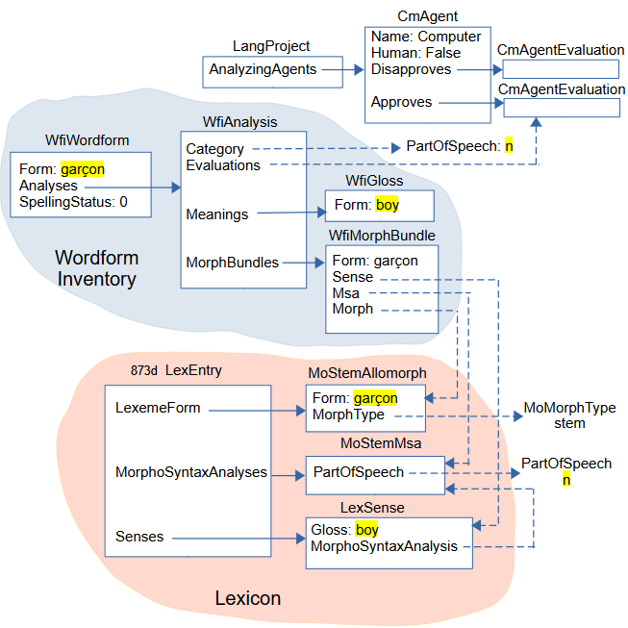
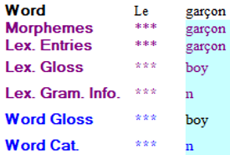
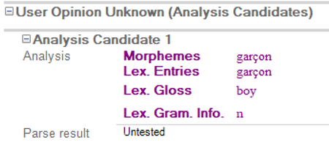
Interlinear: Analyses continued
Preview…

Slide 22


Interlinear: Analyses WfiAnalysis
The ‘garçon’ WfiWordform now owns a WfiAnalysis object.
A WfiAnalysis objects has
Category – atomic reference to a PartOfSpeech in the Category list in the Grammar area. This shows up in the Word Category line of the Analyze tab of an interlinear text.
Meanings – owning collection holding WfiGloss objects. One of these WfiGloss objects will show up in the Word Gloss line of the Analyze tab of an interlinear text.
MorphBundles – owning sequence of WfiMorphBundle. There is one WfiMorphBundle for each morpheme in the wordform analysis.
Evaluations – reference sequence to CmAgentEvaluation approving or disapproving the analysis for one or more CmAgents.

Slide 23
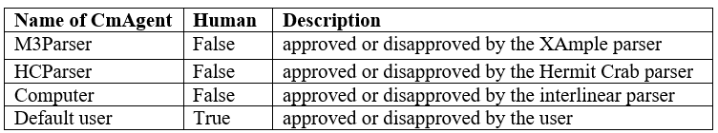
Interlinear: Analyses CmAgent
LangProject owns the following CmAgent objects in the AnalyzingAgents owning collection.
Each CmAgent has an Approves, and a Disapproves property owning a CmAgentEvaluation. Analyses can be approved or disapproved by any of these CmAgents by referencing the desired CmAgentEvaluation through the Evaluations reference collection property on WfiAnalysis. The current suggestions are generated and approved by the Computer parser. At this point it’s up to the user whether they want to approved the analyses or not.

Slide 24

Interlinear: Analyses WfiMorphBundle
WfiMorphBundle has
Form – MultiString form for the morpheme. This form will be displayed in the Morphemes line in the Analyze tab of an interlinear text if the Morph property is empty. Once the Morph property is set, the Morphemes line displays the Form from the referenced MoForm,
Morph – atomic reference to a MoForm, either in the LexemeForm or AlternateForms property of a LexEntry. This Form is displayed in the Lex Entries line in the Analyze tab of an interlinear text.
Msa – atomic reference to a MoMorphSynAnalysis in the Morph entry. This PartOfSpeech in this analysis is displayed in the Lex Gram Info line in the Analyze tab of an interlinear text.
Sense – atomic reference to a LexSense in the Morph entry that shares the Msa referenced by this WfiMorphBundle. The Gloss from this sense is displayed in the Lex Gloss line in the Analyze tab of an interlinear text.

Slide 25
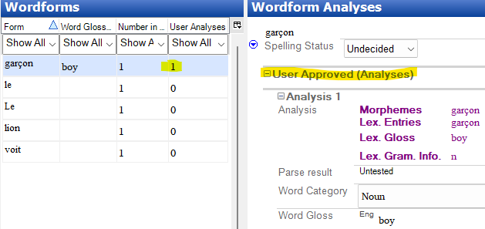
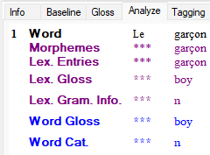
Interlinear: Approving analyses
If the user clicks the green Approve button in ‘garçon’ in the word focus box, the Analyze tab shows (left)
and the Word Analyses tool shows (right)

Slide 26
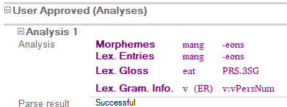
Interlinear: Approving analyses
Two changes occurred in the FLEx data.
In the Segment Analyses list of references for wordforms, the second one that used to reference the ‘garçon’ WfiWordform now references the ‘boy’ WfiGloss object owned in the WfiAnalysis owned by the ‘garçon’ WfiWordform. <rt class="Segment" guid="78220579-5e21-47df-82b1-1fd72a02748d" ownerguid="a51ed87e-d6fe-44d6-a317-1b726d218fe3"> <Analyses> <objsur guid="b0460a42-7e19-460e-9ec8-4779c4a5f3ff" t="r" /> Le <objsur guid="7dec7244-62f4-441f-bfc9-c9564093c2f0" t="r" /> <- garçon WfiGloss 'boy’
In addition to the WfiAnalysis Evaluations referencing the Computer Approves CmAgentEvaluation, it now also references the “default user” Approves CmAgentEvaluation. <rt class="WfiAnalysis" guid="be5aec0f-ff8d-4718-a97d-018a1fcd23d6" ownerguid="40b5890e-abc9-4741-9ef7-8dea5fb88c37"> <Evaluations> <objsur guid="41581e3a-7ed3-41ac-94c7-6e91dbcc108b" t="r" /> <- Computer approves <objsur guid="8caa11bb-cac4-4836-a081-1666245106b9" t="r" /> <- Default user approves </Evaluations>

Slide 27
Interlinear: Summary
In summary, the Analyses property of Segment can reference 4 types of objects.
A WfiWordform with a Form that matches the wordform in the baseline. This indicates the wordform is unanalyzed.
A WfiAnalysis owned by a WfiWordform with a Form that matches the wordform in the baseline. This indicates the wordform is partially analyzed. The analysis is known, but the word gloss has not been chosen.
A WfiGloss owned in a WfiAnalysis owned by a WfiWordform with a Form that matches the wordform in the baseline. This indicates the wordform is fully analyzed to an exact WfiGloss.
A PunctuationForm contains punctuation in the baseline and any strings that are not in the vernacular writing system of the text. They cannot be analyzed.

Slide 28
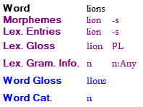
Interlinear: Summary continued
Here’s an example of a word with two morphemes:
The FLEx diagram would be very similar to the previous diagram for ‘garçon’, but the WfiAnalysis MorphBundles property now has two WfiMorphBundle objects; one for ‘lion’ and one for ‘-s’. The first MorphBundle would reference the 3 parts of the ‘lion’ entry, and the second MorphBundle would reference the 3 parts of the ‘-s’ entry.

Slide 29
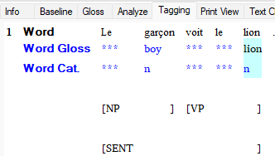
Interlinear: Text Tagging
Interlinear text offers a Tagging tab that allows a user to tag sections of the baseline for Grammatical Relations – Functional, Semantics – RRG, Syntax – Descriptive, or Syntax – RRG. You can also create your own tagging structure. The tags are defined in the Text Markup Tags list in the Lists area. The top-level tags define rows in the tagging system, and subitems provide the tag markings within that line.
In the Interlinear Text Tagging tab you can highlight a string of wordforms and right-click to choose a tag to assign to these wordforms. You can choose from more than one level. The result might look like this

Slide 30
Interlinear: Text Tagging continued
The Text Markup Tags list is owned in the TextMarkupTags property of LangProject. When you add a tag, FLEx adds a TextTag object in the Tags owning collection of StText.
TextTag has
BeginAnalysisIndex – Integer indicating the beginning index of IAnalysis references in the Segment Analyses property.
EndAnalysisIndex – Integer indicating the ending index of IAnalysis references in the Segment Analyses property
BeginSegment – atomic reference to the Segment where the tag begins
EndSegment – atomic reference to the Segment where the tag ends
Tag – atomic reference to CmPossibility in the Text Markup Tags list.

Slide 31
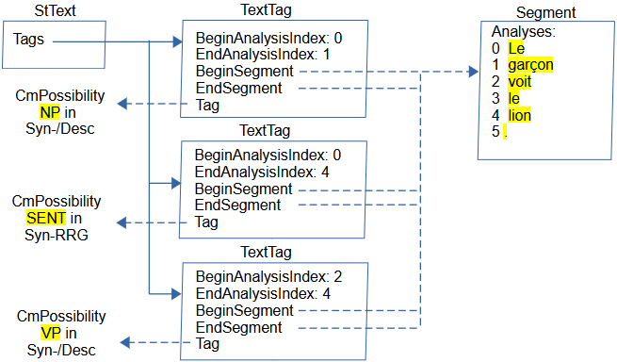
Interlinear: Text Tagging continued
This is how it looks in FLEx

Slide 32
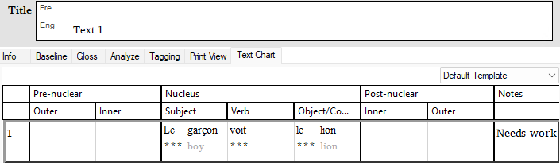
Interlinear: Discourse charting
Interlinear text offers a Text Chart tab that allows a user to add analyses into a discourse chart. The chart structure and markers are in possibility lists that the user can modify to meet their need. Here’s a simple example.

Slide 33
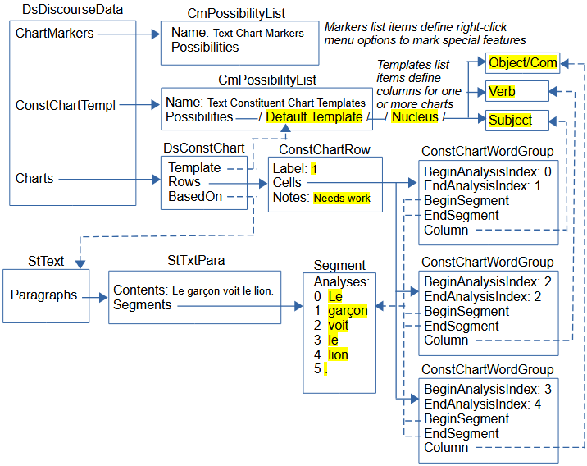
Interlinear: Discourse charting continued
Preview…

Slide 34
Interlinear: Discourse charting continued
Text charts are stored in DsDiscourseData, which is owned in the DiscourseData atomic owning property of LangProject. DsDiscourseData owns two CmPossibilityList objects.
The “Text Constituent Chart Templates” list is owned in the ConstChartTempl atomic owning property and defines the chart structure. This list is hierarchical. The top level is the name of a type of chart. The only one by default is “Default Template”. The second level defines the primary level of columns and headers (Pre-nuclear, Nucleus, and Post-nuclear) separated by black lines. The third level defines secondary columns and headers. (e.g., Nucleus has Subject, Verb, and Object/Complement items) separated by gray lines.
The “Text Chart Markers” list is owned in the ChartMarkers atomic owning property and defines submenus for the right-click menu within cells to mark special features. This list is also hierarchical. The top level defines a right-click subitem. The defaults are TenseAspectMood, Pronouns, and Demonstratives. Lower levels provide actual markers.
DsDiscourseData also has a Charts owning collection that owns DsChart objects. DsChart is a subclass of CmMajorObject, and both of these are abstract. The only actual subclass that is available is DsConstChart.

Slide 35
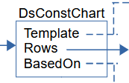
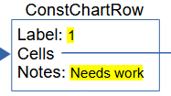
Interlinear: Discourse charting continued
DsConstChart has
Template – atomic reference to CmPossibility. This is one of the top possibilities in the “Text Constituent Chart Templates” list. In this example, it is the “Default Template” item. This is the item that defines the columns for this chart.
BasedOn – atomic reference to StText. This is owned by the Text being charted.
Rows – owning sequence of ConstChartRow objects. There is one ConstChartRow object for each row in the chart. A row corresponds to a StTextPara and is shown in black lines and numbers on the left designating the paragraph number.
ConstChartRow has
Label – String containing the paragraph number and possible letters when there are sub-rows within the row.
Cells – owning sequence of ConstituentChartCellPart which is abstract. Possibilities include
ConstChartClauseMarker – controls dependent clauses.
ConstChartMovedTextMarker – allows word groups to be moved to a different location.
ConstChartTag – inserts a tag before or after a column
ConstChartWordGroup – groups 1 or more Wordforms into a cell.
Notes – String for compiler notes.

Slide 36
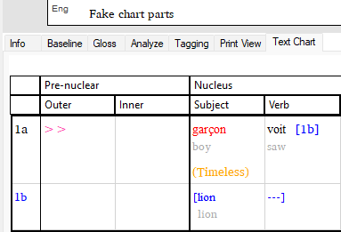
Interlinear: Discourse charting continued
A “Fake chart parts” example text that makes no linguistic sense, but demonstrates the remaining ConstituentChartCellPart classes looks like this in the sample project.
This chart was created with baseline ‘garçon voit lion.’, and bringing ‘garçon’ into the Subject column, ‘voit’ into the Verb column, and ‘lion’ into the Subject column. Right-click ‘garçon’ and choose Mark as Postposed from > Outer. Right-click ‘garçon’ again and choose Mark TenseAspectMood > Timeless > Timeless. Right-click ‘voit’ and choose Make a Dependent Clause out of > Next Clause.

Slide 37
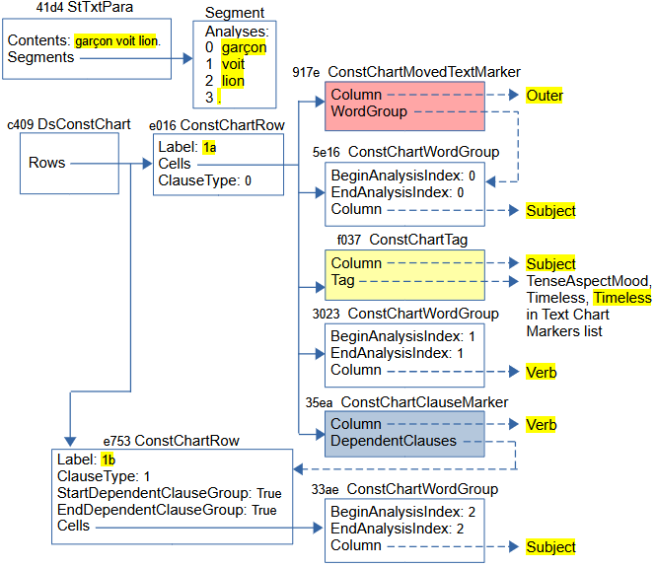
Interlinear: Discourse charting continued
Preview…

Slide 38
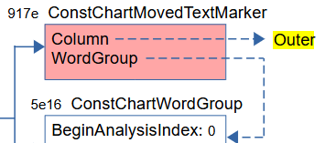
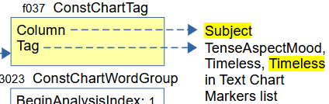

Interlinear: Discourse charting continued
(pink) When you right-click a cell and choose “Mark as Preposed from” or “Mark as Postposed from”, and choose a target column, a ConstChartMovedTextMarker object (e.g., 917e) is placed in the target column. It has a Column property that references the target column CmPossibility, and a WordGroup property that references the source word group from which you gave the command. FLEx adds two wedges in red in the target cell, and it shows the source cell in red.
(yellow) When you right-click a cell and choose one of the last 3 menu items (Mark TenseAspectMood, Mark Pronouns, or Mark Demonstratives) and pick a subitem, a ConstChartTag object (e.g. f037) is inserted in the current cell. It has a Column property that references the current column CmPossibility, and a Tag property that references the selected CmPossibility from the Text Chart Markers list. FLEx adds the CmPossibility name in parentheses in a different color (e.g., Timeless).
(blue) Clauses are in a sub-row by themselves. When you right-click a cell in one sub-row, you can choose one of the ‘Make a <Type> Clause out of’ menu items, you can choose the next or previous clause, a ConstChartClauseMarker object (e.g., 34ea) is inserted in the source cell. It has a Column property referencing a source column CmPossibililty, and a DependentClauses property that references the ConstChartRow that contains the clause. FLEx puts square brackets around the clause, and in the source cell it adds the target row label in square brackets.

Slide 39
Interlinear: Scripture
FieldWorks used to have a Translation Editor program for working on Scripture. Development on TE was stopped when we chose to help develop and work with Paratext for Scripture editing.
The last version of FieldWorks with TE was FW8.3.12.
Although FieldWorks no longer allows editing scripture text, when a Paratext project is associated with a FLEx project, books from Paratext can be imported into FLEx. The data shows up as interlinear texts.
Interlinear analysis can be done on imported scripture, but FLEx does not provide any capability for editing or deleting the imported scripture. If you need to remove scripture from a project, you can use LCM Browser to delete the ScrBook objects.

Slide 40
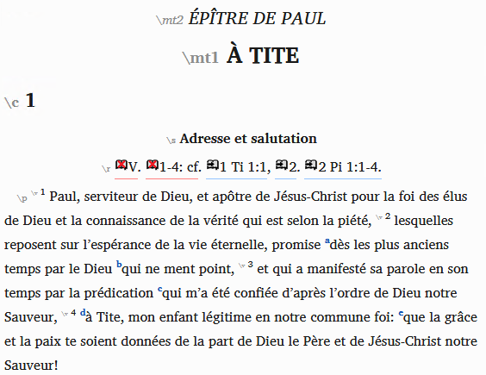
Interlinear: Scripture continued
This is how a section of Titus from the LS1910 French public domain Bible looks in Paratext.

Slide 41
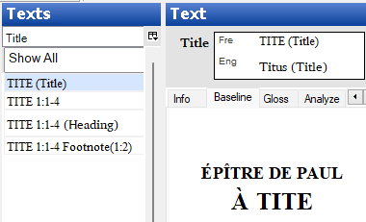
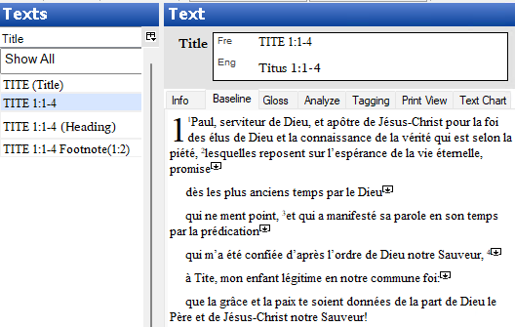
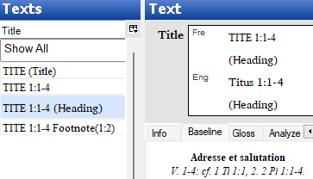
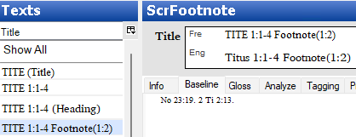
Interlinear: Scripture continued
This section shows up in FLEx as 4 Texts

Slide 42
Interlinear: Scripture continued
LangProject has a TranslatedScriptures atomic owning attribute that owns a Scripture object. Scripture has various properties that are no longer used, but it has an owning sequence of ScrBooks representing books of Scripture, each book in a ScrBook object.
Scripture uses the FLEx structured text classes starting with StText, but instead of StText owning StTxtPara objects, Scripture uses ScrTxtPara objects. In the Interlinear Texts tool, FLEx shows StText objects and ScrFootnote objects as interlinear texts. When showing StText, in the Interlinear Texts it
appends (Title) for the StText owned in the ScrBook Title property
appends (Heading) for the StText owned in the ScrSection Heading property
it doesn’t append anything for the StText owned in the ScrSection Content property
it appends Footnote(c:v) for ScrFootnote with the chapter and verse number in parentheses.
The vernacular ScrBook Name (or Abbrev) is used for the book name, and for StTexts owned in ScrSection, it appends the chapter/verse range for the section.

Slide 43
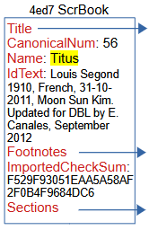
Interlinear: Scripture continued
ScrBook has
CanonicalNum – Integer giving the book number in Scripture starting at 1 for Genesis. The number for Titus, which is used in this example is 56.
Name – MultiUnicode name for the book, used in displaying the Title for FLEx interlinear text.
IdText – Unicode string showing identifying information for the book.
ImportedCheckSum – A calculated checksum of the Paratext book file that is stored when FLEx imports a book from Paratext. When the user goes to the Choose Texts tool and the FLEx project is associated with Paratext, and a ScrBook for this book is already in the FLEx project, then FLEx calculates a current checksum for the Paratext book file, and if it is different, it means the file has been edited in Paratext, so it reimports the book from Paratext and stores the new checksum. When reimporting, FLEx attempts to maintain any interlinearization a user did in FLEx.
Title – atomic owning property holding a StText with the title for the printed book.
Footnotes – an owning sequence of ScrFootnote holding all of the footnotes for the book.
Sections – an owning sequence of ScrSection, which usually includes a section heading and all of the verses until a new chapter or section head occurs.

Slide 44

Interlinear: Scripture continued
ScrTxtPara objects use a StyleRules property to store paragraph style information in a namedStyle prop element giving the name of the style for the paragraph. The Contents String property includes namedStyle attributes with the name of special styles designating a “Chapter Number”, “Verse Number”, “Title Secondary”, etc.

Slide 45
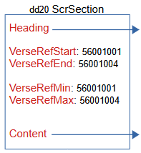
Interlinear: Scripture continued
ScrSection has
VerseRefStart – an Integer representing the book, chapter, and verse that starts this section in the form BBCCCVVV.
VerseRefEnd – an Integer representing the book, chapter, and verse that ends this section in the form BBCCCVVV.
Heading – atomic owning property that holds an StText for the section heading.
Content – atomic owning property that holds an StText for the rest of the paragraphs in a section.

Slide 46
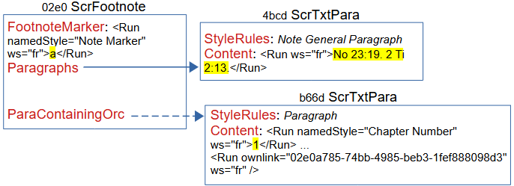
Interlinear: Scripture continued
ScrFootnote has
FootnoteMarker – a String with the footnote marker in a “Note Marker” style.
ParaContainingOrc – an atomic reference to ScrTxtPara that references the paragraph that contains the footnote. In the paragraph, the footnote is represented by an ownlink attribute in the Run with the guid of the ScrFootnote.
Paragraphs – an owning sequence of ScrTxtPara that contains the content of the footnote.

Slide 47
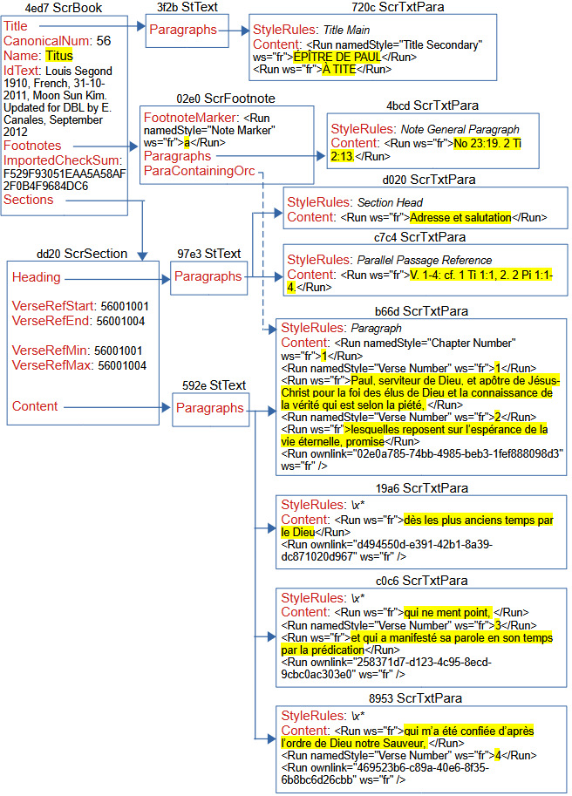
Interlinear: Scripture continued

Slide 48
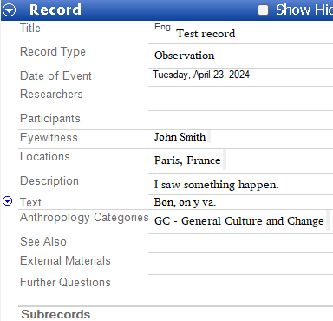
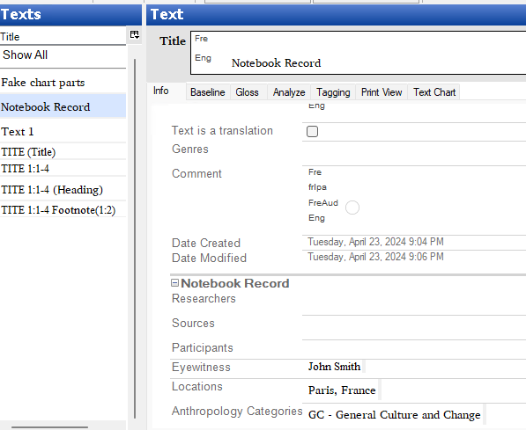
Notebook model
FLEx has a Notebook area that allows a user to record information relating to the culture. Most of the fields in the Notebook are Multi-Paragraph fields with styles for paragraphs and text. A notebook record can reference a text that is an actual Text in Interlinear Texts.
Here’s a sample record with a few fields filled in, and how it looks from a linked interlinear text.

Slide 49
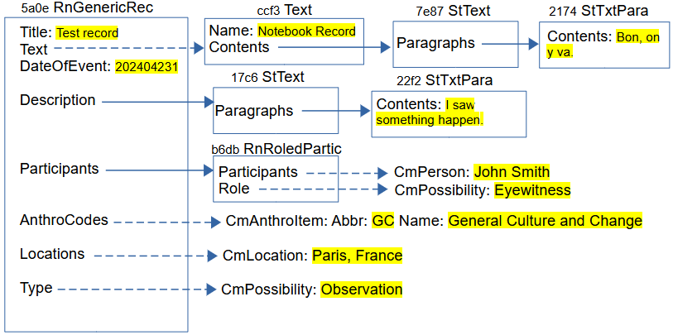
Notebook model continued
RnResearchNbk is owned in LangProject in atomic owning ResearchNotebook property. RnReserachNbk has a Records owning collection of RnGenericRec.
This is represented in FLEx as
Optional Text that shows up in Interlinear Text. It does this through the atomic reference Text property. The view in the Notebook just shows the baseline text. The view in the Interlinear Text Info tab shows some of the information from the Notebook record.
Description, and several other fields, are atomic owning properties holding a StText, which owns any number of StTxtPara objects that can have paragraph and character styles.
Participants property references CmPerson objects from the People list. It also has a Role atomic reference to CmPossibility from the Roles list.
AnthroCodes reference collection to CmAnthroItem. The display typically shows the abbreviation and name of the anthro items.
Locations reference collection to CmLocation objects in the Locations list.
Type property referencing one of the CmPossibility items in the Notebook Record Types list.

Slide 50
Documentation
FLEx 9.1 Conceptual Model documentation covered in these webinars is available as “FLEx 9.1 Conceptual model.pdf” in software.sil.org/fieldworks/support/technical-documents https://downloads.languagetechnology.org/fieldworks/Documentation/FLEx%209.1%20Conceptual%20Model.pdf (The file also has a link to a Flex 9.1 sample project used in this document, as well as the three PowerPoint presentations.)

